Slide 1
Financial Aid 101
Kevin Ware, Regional Admissions
Grand Canyon University

Slide 2
Five Expenses to Consider CollegeBoard.com, 2014
AVERAGE TUITION AND FEES
2-year Colleges: $3,690/ year
Public Schools In-State: $10,240/year
Public Schools Out-of-State: $25,770/year
Private Universities: $33,500/ yr
ROOM AND BOARD
Additional $9,000 per year
PERSONAL EXPENSES
TEXTBOOKS AND SUPPLIES
$700-$1,100 per year
TRANSPORTATION

Slide 3
Types of Financial Aid
Scholarships
Federal Financial Aid
Work Study
Grants
Loans

Slide 4
Scholarships

Slide 5
Types of Scholarships
Institutional Scholarships
Funding from the university
Ask about the eligibility requirements
How to apply?
Are they renewable?
Private Scholarships
Funding from outside organizations- not university specific
How do I receive this scholarship award?
Is this scholarship renewable?
Do I receive the scholarship money or does the university?

Slide 6
GCU FRESHMEN ACADEMIC SCHOLARSHIPS
Chancellor Scholarship ($10,750 per year)
Minimum incoming 4.0 GPA (un-weighted)
Maintain minimum 3.75 GPA as well as continuous and full-time enrollment
President Scholarship ($8,750 per year)
Minimum incoming 3.9 GPA (un-weighted) or SAT: 1350 / ACT: 31
Maintain minimum 3.5 GPA as well as continuous and full-time enrollment at GCU
Provost’s Scholarship ($7,750 per year)
Minimum incoming 3.7 GPA (un-weighted) or SAT: 1225 / ACT: 27
Maintain minimum 3.3 GPA as well as continuous and full-time enrollment at GCU
Dean Scholarship ($6,750 per year)
Minimum incoming 3.5 GPA (un-weighted) or SAT: 1100 / ACT: 24
Maintain minimum 3.2 GPA as well as continuous and full-time enrollment at GCU
Faculty Scholarship ($5,750 per year)
Minimum incoming 3.3 GPA (un-weighted) or SAT: 1050 / ACT: 22
Maintain minimum 3.0 GPA as well as continuous and full-time enrollment at GCU
Antelope Scholarship ($4,750 per year)
Minimum incoming 3.0 GPA (un-weighted) or SAT: 1000 / ACT: 20
Maintain minimum 3.0 GPA as well as continuous and full-time enrollment at GCU

Slide 7
Free Scholarship Websites
www.fastweb.com
www.petersons.com
www.supercollege.com
www.finaid.org
www.students.gov
www.collegenet.com
www.wiredscholar.com
www.collegeboard.com

Slide 8
Sources for Outside Scholarships
Ask your employer about tuition assistance benefits
Your parents’ and relatives’ employers
Church or volunteer groups
Performance Awards
Opportunities within your school district
Clubs
ROTC
Athletics

Slide 9
Applying for Federal Financial Aid
What does FAFSA stand for?

Slide 10
Free Application for Federal Student Aid (FSA ID)
Apply after October 1st
What do you need?
Current Tax Information
Social Security Number
Driver’s License Number
PIN Number
Application available at:
www.fsaid.ed.gov

Slide 11
FSA ID (ID)
First Step:
Apply for a FSA ID
Go to www.fsaid.ed.gov
Parent and student need to apply for a pin number
Free to apply
Why do I need a ID?
Sign FAFSA electronically

Slide 12
Independent vs. Dependent Status
What’s the difference?
Independent Status
Must be 24 or older
Enlisted or veteran of the U.S. military
Married
Have children or dependents
Working towards your Master’s or Doctoral degree
Deceased Parents or Ward of the State
Unaccompanied youth or homeless
If you do not meet the above requirements, you are a “Dependent Student”

Slide 13
Enter Tax Information
IRS Data Retrieval Tool (DRT)
Enter personal information
Use DRT tool to import most recent tax information
Double check for accuracy

Slide 14
Electronically Sign
Use your PIN to electronically sign your FAFSA Application
Parent will use PIN to electronically sign

Slide 15
Confirmation Page
What is an EFC number?
What does it mean to me?

Slide 16
What happens after I submit my FAFSA Application?
FAFSA Application can be sent to up to 10 colleges or universities
Two weeks to process FAFSA application
Follow up and send information that is requested

Slide 17
Verification Process
Am I selected for FAFSA Verification?
Random selection process
Requires the student to provide additional documentation before application and awards can be processed
Dependency Verification Worksheet
Source of Income Worksheet
Asset Verification Worksheet
Don’t procrastinate! This process can take 6-8 weeks to process.

Slide 18
Federal Work Study (FWS)
Student worker position on campus
FWS jobs found in Career Services Office
Weekly hours and wage pre-determined based on eligibility
Ask your financial aid office about eligibility and if you qualify!
How is this different from any other student worker job on campus?
FWS jobs are government funded
Non-FWS jobs are college or university funded

Slide 19
Grants
Typically Income and Need Based
Federal-Pell Grant
Federal-Supplemental Educational Opportunity Grant (FSEOG)
Teacher Education Assistance for College and Higher Education Grant (TEACH)

Slide 20
Student and Parent Loan Options

Slide 21
Student Loans
FAFSA Loans
Subsidized
Unsubsidized
Alternative Loans
Offered at some local banks and private organizations
Credit Based
Co-Signer may be needed
Nearly 84% of students graduate with student loan debt
In 2014, the average student loan debt was $28,660

Slide 22
Parent PLUS Loans
To apply, visit www.studentloans.gov
Credit based loan application for parent to complete
Loan can be used to assist student with tuition and fees
Repayment begins 60 days after loan is disbursed
Notes:
GCU has a cap which is 10,000 a year. You can choose to take what you need.
Around 750 credit score. If you get denied, then you can increase your student loan by $4,000.

Slide 23
Entrance Interview (EI) Master Promissory Note (MPN)
Notes:
20 minute page-40 min process

Slide 24
Timeline Review
October-November: Apply for an FAFSA ID
October-February: Apply for financial aid at www.fafsa.ed.gov
March-April: Provide additional documentation if needed- Verification?
April-May: Follow up with Financial Aid Office to verify awards
May-July: Enjoy your summer and get ready to go to college!!!

Slide 25
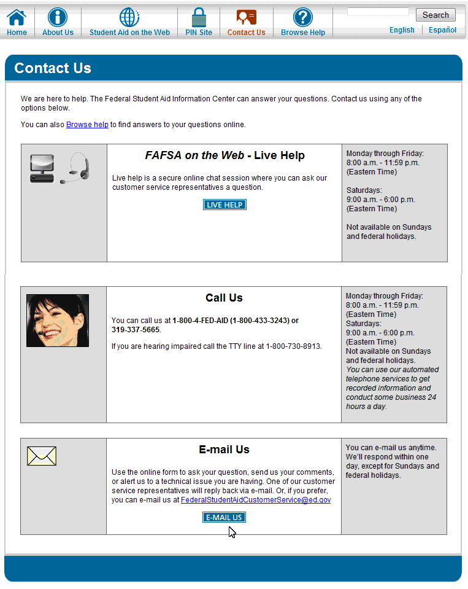
Questions?

Slide 26
Contact Information:
Kevin Ware
Grand Canyon University
Phone 951-312-6376
Email: kevin.ware@gcu.edu

