Slide 1
Paying for College

Slide 2
The Scholarship Myth
72% of parents believe their children
have special talents that will enable them
to pay the majority of his/her college
costs

Slide 3
Where Will I Find the Money?
Federal Government
State Government
Institution (college/university/trade school)
Private
Families
Earnings
Savings

Slide 4
Types of Financial Aid
Grants
Scholarships
Loans
Work-Study

Slide 5
Financial Aid Forms
FAFSA (Free Application for Federal Student Aid)
CADream Act ( non-resident students)
Cal Grant – California colleges only
Chafee Grant – foster children only
CSS Profile – for some private colleges
Institutional – for some colleges

Slide 6
The Federal Philosophy
Parents are responsible for student’s education to the extent that they are able
Parent responsible until student:
Is 24 years old
Supports their own children
Is a veteran of U.S. armed forces
Is classified as independent

Slide 7
How Financial Need is Determined
Cost of Attendance (COA) $25,000
Expected Family Contribution (EFC) - 10,000
Financial Need $15,000
This is the amount that Financial Aid Office will try to come up with. It is what is called a Financial Aid Package

Slide 8
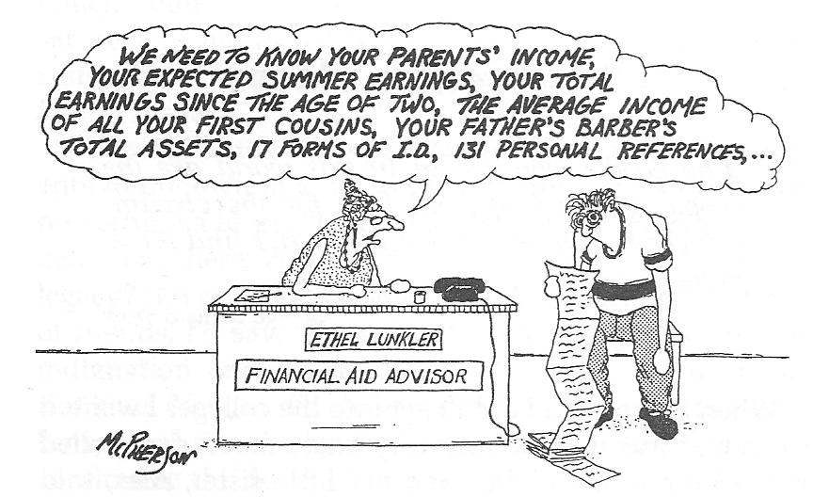
FAFSA
Go to www.fafsa.ed.gov
Complete FAFSA (Oct 1st – March 2nd )

Slide 9
FAFSA Hooray
http://www.youtube.com/watch?v=e2d7IfFgxTs

Slide 10
Cal Grant
G.P.A. Verification Form
Calculate student’s G.P.A.
Amounts:
C.S.U. $5,742
UC $12,570
Private $9,084

Slide 11
Chafee Grant
Current or former foster youth
Submit FAFSA & CA Chaffee Grant form on-line
Grant up to $5000 can be used in various ways

Slide 12
Institutional Grants
California Community College
Board of Governors’ Fee Waiver
CSU System
State University Grant
UC System
University of California Student Aid
Private Schools
Scholarships, endowments, foundations

Slide 13
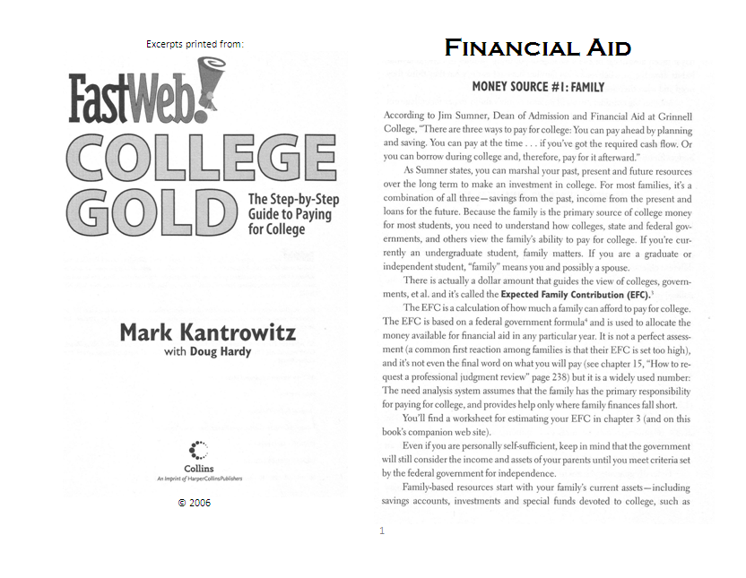
Read on Your Own

